Slide 1
Final Project 3
By: Moez Vellani

Slide 2
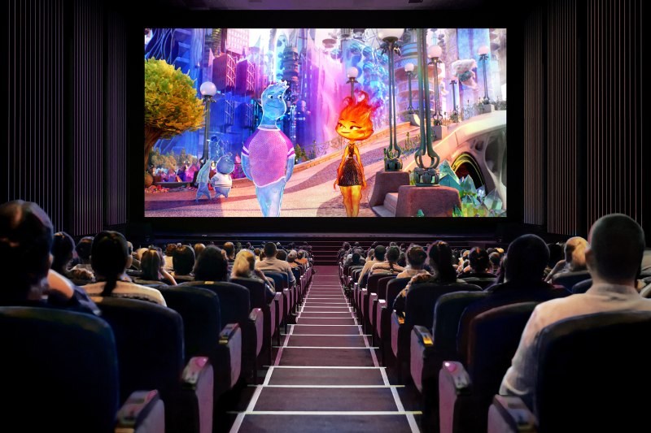
Goal?

Slide 3
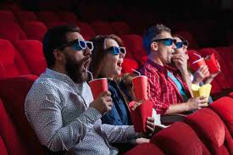
The Goal
Create a model that could recommend movies based on the users criteria.
Have various filtering options to find a specific movie.
Integrate an interface for the user to input values and receive and output.

Slide 4
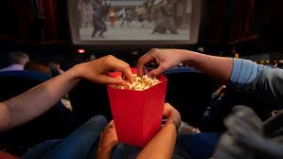
Result
Ended up with three prototypes.
Prototype One: recommends movies based on the chosen genre but returns every movie within that genre.
Prototype Two: recommends only one movie with the highest rating based on the genre that is chosen.
Prototype Three: Based on the movie title that is entered it will then output an emotion that you can expect to feel during and after the movie.

Slide 5
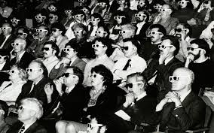
The Cons
Prototype One: Does not output a specific movie.
Prototype Two: Once you have gone through every genre, the model becomes useless.
Prototype Three: The emotional classifier is not accurate sometimes.

Slide 6
Demonstration

Slide 7
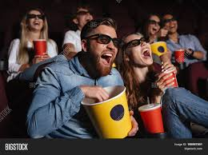
Future Changes
Add additional filtering methods to prototype two.
Make prototype three more accurate.
Possibly combine prototype two and three.

Slide 8
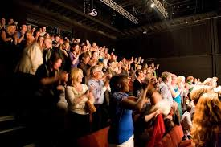
Conclusion
Created three versions of the movie recommender.
Each one outputs a different value and has their own unique con.
Current Goal is to now improve each model with future changes.

Slide 9
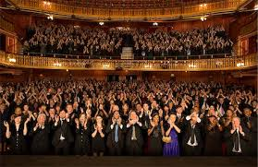
End!

